Slide 1
Inventory Management System

Slide 2
Introduction
IMS is an application in which an end user can interact with via a Command-Line Interface (CLI).
Application is based on CRUD functionality.
CRUD functionality following the Enterprise Architecture Model for the customers, items, and orders entities
The project connects via JDBC to a local or GCP-based MySQL instance
Sensible package structure
Adherence to best practice (e.g. OOP principles, SOLID, refactoring)

Slide 3
Introduction
The application needs to be able to:
Add a customer to the system
View all customers in the system
Update a customer in the system
Delete a customer in the system
Add an item to the system
View all items in the system
Update an item in the system
Delete an item in the system
Create an order in the system
View all orders in the system
Delete an order in the system
Add an item to an order
Calculate a cost for an order
Delete an item in an order

Slide 4
Tools
Followings are the tools that we have used in project:
Version Control System: Git
Source Code Management: GitHub
Scrum Board: Jira
Database Management System: MySQL Server 5.7+ (local or GCP instance)
Back-End Programming Language: Java
Build Tool: Maven
Unit Testing: Junit & Mockito

Slide 5
Objective
The overall objective of the project is the following:
“To create a functional application – using supporting tools, methodologies, and technologies – which encapsulates all fundamental modules covered during training”

Slide 6
Objective
The overall objective of the project is the following:
“To create a functional application – using supporting tools, methodologies, and technologies – which encapsulates all fundamental modules covered during training”

Slide 7
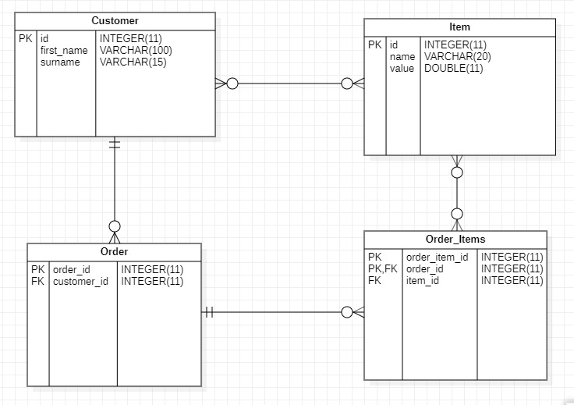
ERD

Slide 8
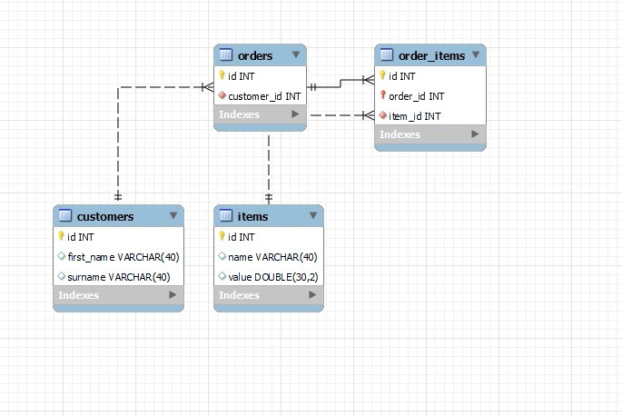
UML

Slide 9
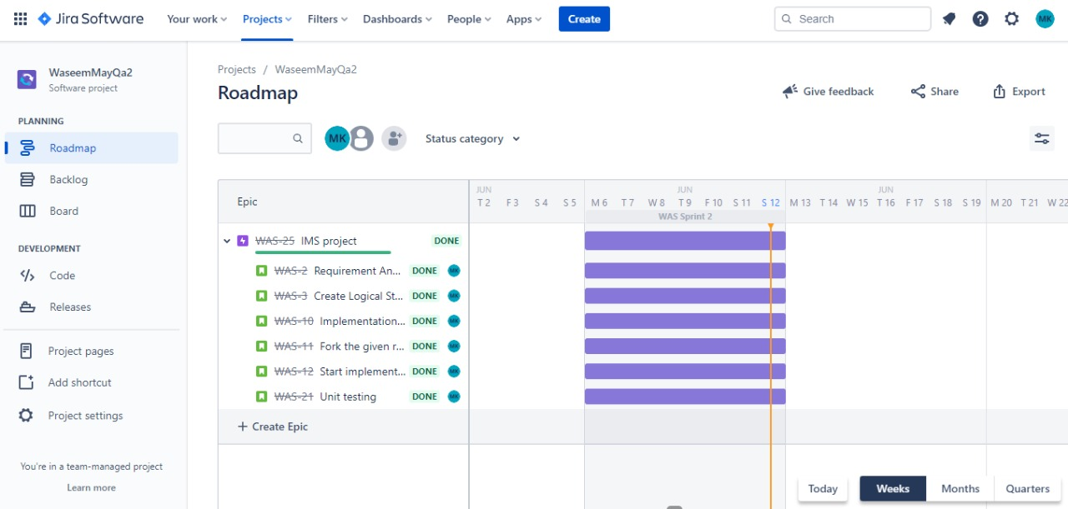
Project management using Jira

Slide 10
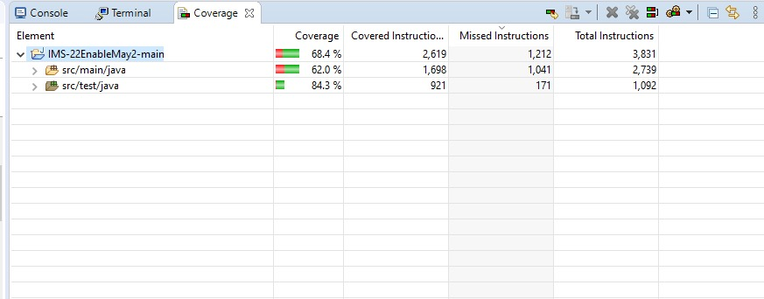
Project Coverage

Slide 11
Developers Journey
Prior to training:
Previously no SQL experience or Java experience
No experience in coding
Now:
Completed an Inventory Management App using SQL and JAVA
Along with Jira and MoSCoW method

Slide 12
Thank you

